Slide 1
Last time: Summary
Definition of AI?
Turing Test?
Intelligent Agents:
Anything that can be viewed as perceiving its environment through sensors and acting upon that environment through its effectors to maximize progress towards its goals.
PAGE (Percepts, Actions, Goals, Environment)
Described as a Perception (sequence) to Action Mapping: f : P* → A
Using look-up-table, closed form, etc.
Agent Types: Reflex, state-based, goal-based, utility-based
Rational Action: The action that maximizes the expected value of the performance measure given the percept sequence to date

Slide 2
Outline: Problem solving and search
Introduction to Problem Solving
Complexity
Uninformed search
Problem formulation
Search strategies: depth-first, breadth-first
Informed search
Search strategies: best-first, A*
Heuristic functions

Slide 3
Example: Measuring problem!
9 l
5 l
3 l
Problem: Using these three buckets,
measure 7 liters of water.

Slide 4
Example: Measuring problem!
(one possible) Solution:
a b c
0 0 0 start
3 0 0
0 0 3
3 0 3
0 0 6
3 0 6
0 3 6
3 3 6
1 5 6
0 5 7 goal
9 l
5 l
3 l
a
b
c

Slide 5
Example: Measuring problem!
(one possible) Solution:
a b c
0 0 0 start
3 0 0
0 0 3
3 0 3
0 0 6
3 0 6
0 3 6
3 3 6
1 5 6
0 5 7 goal
9 l
5 l
3 l
a
b
c

Slide 6
Example: Measuring problem!
(one possible) Solution:
a b c
0 0 0 start
3 0 0
0 0 3
3 0 3
0 0 6
3 0 6
0 3 6
3 3 6
1 5 6
0 5 7 goal
9 l
5 l
3 l
a
b
c

Slide 7
Example: Measuring problem!
(one possible) Solution:
a b c
0 0 0 start
3 0 0
0 0 3
3 0 3
0 0 6
3 0 6
0 3 6
3 3 6
1 5 6
0 5 7 goal
9 l
5 l
3 l
a
b
c

Slide 8
Example: Measuring problem!
(one possible) Solution:
a b c
0 0 0 start
3 0 0
0 0 3
3 0 3
0 0 6
3 0 6
0 3 6
3 3 6
1 5 6
0 5 7 goal
9 l
5 l
3 l
a
b
c

Slide 9
Example: Measuring problem!
(one possible) Solution:
a b c
0 0 0 start
3 0 0
0 0 3
3 0 3
0 0 6
3 0 6
0 3 6
3 3 6
1 5 6
0 5 7 goal
9 l
5 l
3 l
a
b
c

Slide 10
Example: Measuring problem!
(one possible) Solution:
a b c
0 0 0 start
3 0 0
0 0 3
3 0 3
0 0 6
3 0 6
0 3 6
3 3 6
1 5 6
0 5 7 goal
9 l
5 l
3 l
a
b
c

Slide 11
Example: Measuring problem!
(one possible) Solution:
a b c
0 0 0 start
3 0 0
0 0 3
3 0 3
0 0 6
3 0 6
0 3 6
3 3 6
1 5 6
0 5 7 goal
9 l
5 l
3 l
a
b
c

Slide 12
Example: Measuring problem!
(one possible) Solution:
a b c
0 0 0 start
3 0 0
0 0 3
3 0 3
0 0 6
3 0 6
0 3 6
3 3 6
1 5 6
0 5 7 goal
9 l
5 l
3 l
a
b
c

Slide 13
Example: Measuring problem!
(one possible) Solution:
a b c
0 0 0 start
3 0 0
0 0 3
3 0 3
0 0 6
3 0 6
0 3 6
3 3 6
1 5 6
0 5 7 goal
9 l
5 l
3 l
a
b
c

Slide 14
Example: Measuring problem!
Another Solution:
a b c
0 0 0 start
0 5 0
3 2 0
0 0 3
3 0 3
0 0 6
3 0 6
0 3 6
3 3 6
1 5 6
0 5 7 goal
9 l
5 l
3 l
a
b
c

Slide 15
Example: Measuring problem!
Another Solution:
a b c
0 0 0 start
0 5 0
3 2 0
0 0 3
3 0 3
0 0 6
3 0 6
0 3 6
3 3 6
1 5 6
0 5 7 goal
9 l
5 l
3 l
a
b
c

Slide 16
Example: Measuring problem!
Another Solution:
a b c
0 0 0 start
0 5 0
3 2 0
3 0 2
3 0 3
0 0 6
3 0 6
0 3 6
3 3 6
1 5 6
0 5 7 goal
9 l
5 l
3 l
a
b
c

Slide 17
Example: Measuring problem!
Another Solution:
a b c
0 0 0 start
0 5 0
3 2 0
3 0 2
3 5 2
0 0 6
3 0 6
0 3 6
3 3 6
1 5 6
0 5 7 goal
9 l
5 l
3 l
a
b
c

Slide 18
Example: Measuring problem!
Another Solution:
a b c
0 0 0 start
0 5 0
3 2 0
3 0 2
3 5 2
3 0 7 goal
3 0 6
0 3 6
3 3 6
1 5 6
0 5 7 goal
9 l
5 l
3 l
a
b
c

Slide 19
Which solution do we prefer?
Solution 1:
a b c
0 0 0 start
3 0 0
0 0 3
3 0 3
0 0 6
3 0 6
0 3 6
3 3 6
1 5 6
0 5 7 goal
Solution 2:
a b c
0 0 0 start
0 5 0
3 2 0
3 0 2
3 5 2
3 0 7 goal

Slide 20
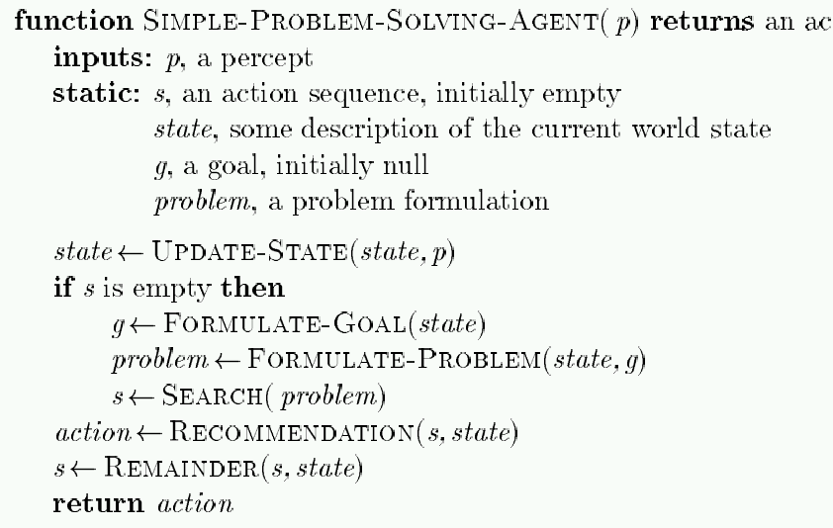
Problem-Solving Agent
action
// What is the current state?
// From LA to San Diego (given curr. state)
// e.g., Gas usage
// If fails to reach goal, update
Note: This is offline problem-solving. Online problem-solving involves acting w/o complete knowledge of the problem and environment

Slide 21
Example: Buckets
Measure 7 liters of water using a 3-liter, a 5-liter, and a 9-liter buckets.
Formulate goal: Have 7 liters of water
in 9-liter bucket
Formulate problem:
States: amount of water in the buckets
Operators: Fill bucket from source, empty bucket
Find solution: sequence of operators that bring you
from current state to the goal state

Slide 22
Remember (lecture 2): Environment types
Environment | Accessible | Deterministic | Episodic | Static | Discrete
Operating System | Yes | Yes | No | No | Yes
Virtual Reality | Yes | Yes | Yes/No | No | Yes/No
Office Environment | No | No | No | No | No
Mars | No | Semi | No | Semi | No
The environment types largely determine the agent design.

Slide 23
Problem types
Single-state problem: deterministic, accessible
Agent knows everything about world, thus can
calculate optimal action sequence to reach goal state.
Multiple-state problem: deterministic, inaccessible
Agent must reason about sequences of actions and
states assumed while working towards goal state.
Contingency problem: nondeterministic, inaccessible
Must use sensors during execution
Solution is a tree or policy
Often interleave search and execution
Exploration problem: unknown state space
Discover and learn about environment while taking actions.

Slide 24
Problem types
Single-state problem: deterministic, accessible
Agent knows everything about world (the exact state),
Can calculate optimal action sequence to reach goal state.
E.g., playing chess. Any action will result in an exact state

Slide 25
Problem types
Multiple-state problem: deterministic, inaccessible
Agent does not know the exact state (could be in any of the possible states)
May not have sensor at all
Assume states while working towards goal state.
E.g., walking in a dark room
If you are at the door, going straight will lead you to the kitchen
If you are at the kitchen, turning left leads you to the bedroom
…

Slide 26
Problem types
Contingency problem: nondeterministic, inaccessible
Must use sensors during execution
Solution is a tree or policy
Often interleave search and execution
E.g., a new skater in an arena
Sliding problem.
Many skaters around

Slide 27
Problem types
Exploration problem: unknown state space
Discover and learn about environment while taking actions.
E.g., Maze

Slide 28
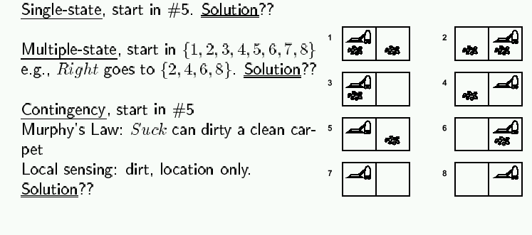
Example: Vacuum world
Simplified world: 2 locations, each may or not contain dirt,
each may or not contain vacuuming agent.
Goal of agent: clean up the dirt.

Slide 29
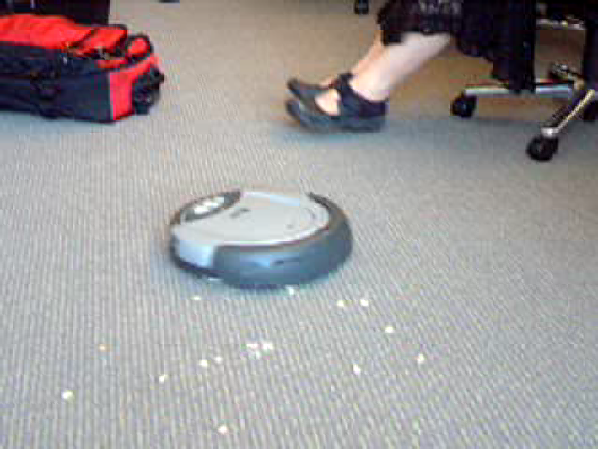

Slide 30
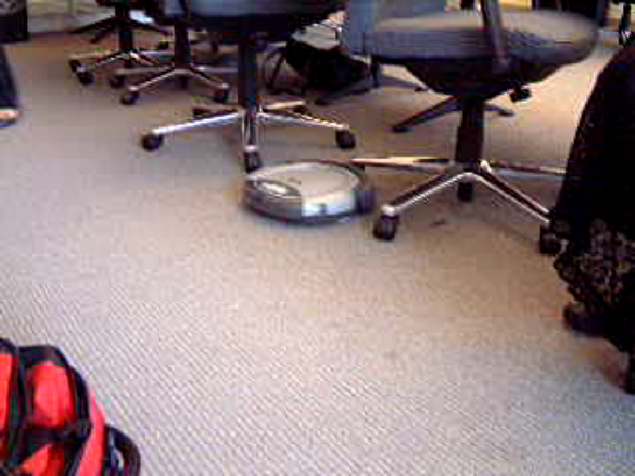

Slide 31


Slide 32
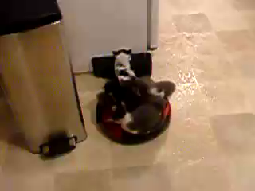

Slide 33
Example: Romania
In Romania, on vacation. Currently in Arad.
Flight leaves tomorrow from Bucharest.
Formulate goal:
be in Bucharest
Formulate problem:
states: various cities
operators: drive between cities
Find solution:
sequence of cities, such that total driving distance is minimized.

Slide 34
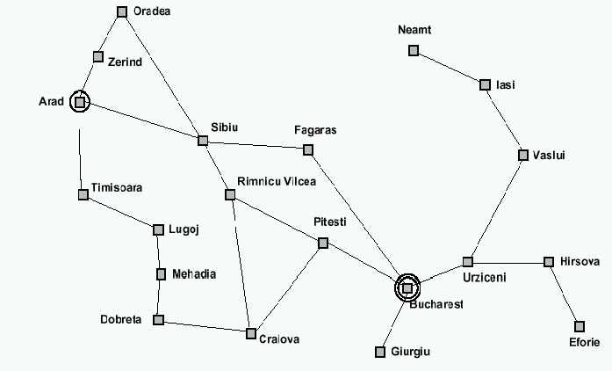
Example: Traveling from Arad To Bucharest

Slide 35
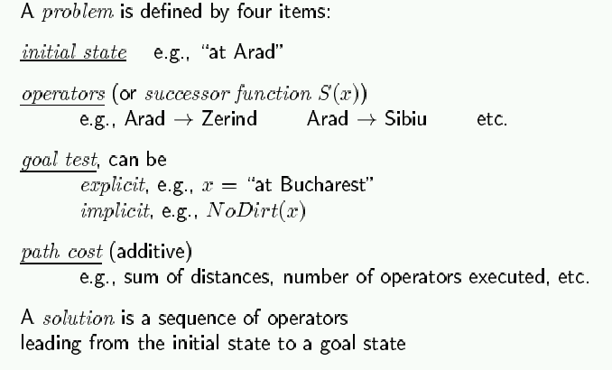
Problem formulation

Slide 36
Selecting a state space
Real world is absurdly complex; some abstraction is necessary to allow us to reason on it…
Selecting the correct abstraction and resulting state space is a difficult problem!
Abstract states ⬄ real-world states
Abstract operators ⬄ sequences or real-world actions
(e.g., going from city i to city j costs Lij ⬄ actually drive from city i to j)
Abstract solution ⬄ set of real actions to take in the
real world such as to solve problem

Slide 37
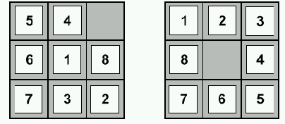
Example: 8-puzzle
start state
goal state
State:
Operators:
Goal test:
Path cost:

Slide 38
Example: 8-puzzle
start state
goal state
State: integer location of tiles (ignore intermediate locations)
Operators: moving blank left, right, up, down (ignore jamming)
Goal test: does state match goal state?
Path cost: 1 per move

Slide 39
Example: 8-puzzle
start state
goal state
Why search algorithms?
8-puzzle has 362,880 states
15-puzzle has 10^12 states
24-puzzle has 10^25 states
So, we need a principled way to look for a solution in these huge search spaces…

Slide 40
Back to Vacuum World

Slide 41
Back to Vacuum World

Slide 42
Example: Robotic Assembly

Slide 43
Real-life example: VLSI Layout
Given schematic diagram comprising components (chips, resistors, capacitors, etc) and interconnections (wires), find optimal way to place components on a printed circuit board, under the constraint that only a small number of wire layers are available (and wires on a given layer cannot cross!)
“optimal way”??
minimize surface area
minimize number of signal layers
minimize number of vias (connections from one layer to another)
minimize length of some signal lines (e.g., clock line)
distribute heat throughout board
etc.

Slide 44
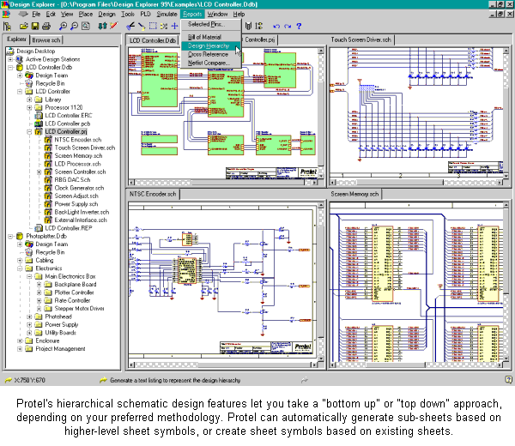
Enter schematics;
do not worry about placement & wire crossing

Slide 46
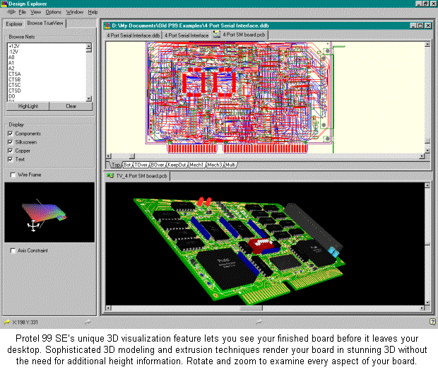
Use automated tools to place components
and route wiring.

Slide 47
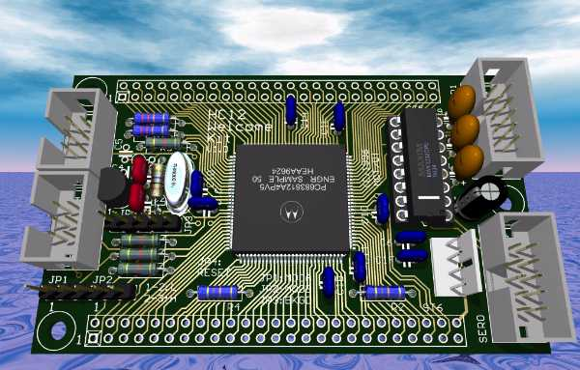

Slide 48
Search algorithms
Basic idea:
offline, systematic exploration of simulated state-space by generating successors of explored states (expanding)
Function General-Search(problem, strategy) returns a solution, or failure
initialize the search tree using the initial state problem
loop do
if there are no candidates for expansion then return failure
choose a leaf node for expansion according to strategy
if the node contains a goal state then
return the corresponding solution
else expand the node and add resulting nodes to the search tree
end

Slide 49
Last time: Problem-Solving
Problem solving:
Goal formulation
Problem formulation (states, operators)
Search for solution
Problem formulation:
Initial state
?
?
?
Problem types:
single state: accessible and deterministic environment
multiple state: ?
contingency: ?
exploration: ?

Slide 50
Last time: Problem-Solving
Problem solving:
Goal formulation
Problem formulation (states, operators)
Search for solution
Problem formulation:
Initial state
Operators
Goal test
Path cost
Problem types:
single state: accessible and deterministic environment
multiple state: ?
contingency: ?
exploration: ?

Slide 51
Last time: Problem-Solving
Problem solving:
Goal formulation
Problem formulation (states, operators)
Search for solution
Problem formulation:
Initial state
Operators
Goal test
Path cost
Problem types:
single state: accessible and deterministic environment
multiple state: inaccessible and deterministic environment
contingency: inaccessible and nondeterministic environment
exploration: unknown state-space

Slide 52
Last time: Finding a solution
Solution: is ???
Basic idea: offline, systematic exploration of simulated state-space by generating successors of explored states (expanding)
Function General-Search(problem, strategy) returns a solution, or failure
initialize the search tree using the initial state problem
loop do
if there are no candidates for expansion then return failure
choose a leaf node for expansion according to strategy
if the node contains a goal state then return the corresponding solution
else expand the node and add resulting nodes to the search tree
end

Slide 53
Last time: Finding a solution
Solution: is a sequence of operators that bring you from current state to the goal state.
Basic idea: offline, systematic exploration of simulated state-space by generating successors of explored states (expanding).
Function General-Search(problem, strategy) returns a solution, or failure
initialize the search tree using the initial state problem
loop do
if there are no candidates for expansion then return failure
choose a leaf node for expansion according to strategy
if the node contains a goal state then return the corresponding solution
else expand the node and add resulting nodes to the search tree
end
Strategy: The search strategy is determined by ???

Slide 54
Last time: Finding a solution
Solution: is a sequence of operators that bring you from current state to the goal state
Basic idea: offline, systematic exploration of simulated state-space by generating successors of explored states (expanding)
Function General-Search(problem, strategy) returns a solution, or failure
initialize the search tree using the initial state problem
loop do
if there are no candidates for expansion then return failure
choose a leaf node for expansion according to strategy
if the node contains a goal state then return the corresponding solution
else expand the node and add resulting nodes to the search tree
end
Strategy: The search strategy is determined by the order in which the nodes are expanded.

Slide 55
Example: Traveling from Arad To Bucharest

Slide 56
From problem space to search tree
Some material in this and following slides is from
http://www.cs.kuleuven.ac.be/~dannyd/FAI/ check it out!
3
A
4
B
4
C
Problem space
S
5
5
G
4
D
E
F
3
2
4
3
S
4
4
A
D
Associated
loop-free
search tree
5
5
2
B
D
A
E
4
5
2
4
5
4
C
E
E
B
B
F
2
4
5
4
4
5
4
4
3
D
F
B
F
C
E
A
C
G
3
4
3
4
G
C
G
F
G
3

Slide 57
Paths in search trees
Denotes:
SA
S
A
Denotes:SDA
D
B
D
A
E
C
E
E
B
B
F
D
F
B
F
C
E
A
C
G
Denotes:
SDEBA
G
C
G
F
G

Slide 58

General search example

Slide 59
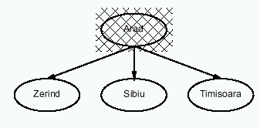
General search example

Slide 60
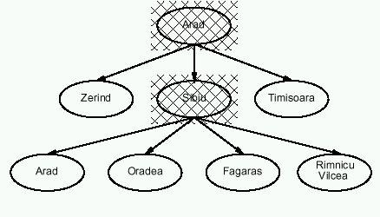
General search example

Slide 61
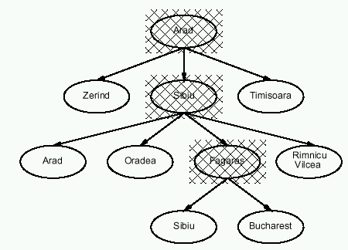
General search example

Slide 62
Implementation of search algorithms
Function General-Search(problem, Queuing-Fn) returns a solution, or failure
nodes ← make-queue(make-node(initial-state[problem]))
loop do
if nodes is empty then return failure
node ← Remove-Front(nodes)
if Goal-Test[problem] applied to State(node) succeeds then return node
nodes ← Queuing-Fn(nodes, Expand(node, Operators[problem]))
end
Queuing-Fn(queue, elements) is a queuing function that inserts a set of elements into the queue and determines the order of node expansion. Varieties of the queuing function produce varieties of the search algorithm.

Slide 63
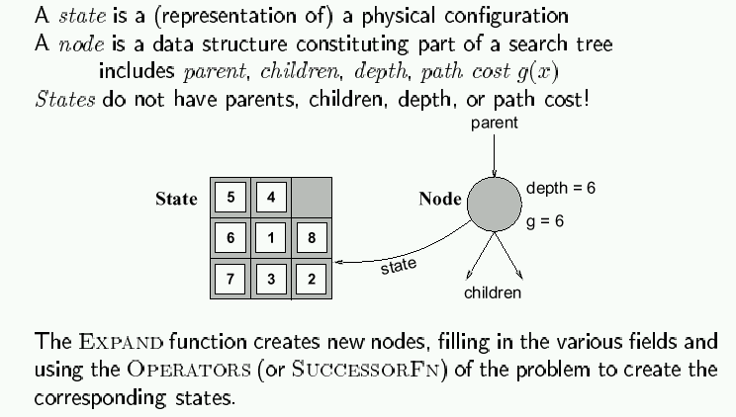
Encapsulating state information in nodes

Slide 64
Evaluation of search strategies
A search strategy is defined by picking the order of node expansion.
Search algorithms are commonly evaluated according to the following four criteria:
Completeness: does it always find a solution if one exists?
Time complexity: how long does it take as function of num. of nodes?
Space complexity: how much memory does it require?
Optimality: does it guarantee the least-cost solution?
Time and space complexity are measured in terms of:
b – max branching factor of the search tree
d – depth of the least-cost solution
m – max depth of the search tree (may be infinity)

Slide 65
Binary Tree Example
Depth = 0
root
Depth = 1
N1
N2
N3
N4
N5
N6
Depth = 2
Number of nodes: n = 2 ^{max depth}
Number of levels (max depth) = log(n) (could be n)

Slide 66
Complexity
Why worry about complexity of algorithms?
because a problem may be solvable in principle but may take too long to solve in practice

Slide 67
Complexity: Tower of Hanoi

Slide 68
Complexity: Tower of Hanoi

Slide 69
Complexity: Tower of Hanoi
3-disk problem: 2³ - 1 = 7 moves
64-disk problem: 2⁶⁴ - 1.
2¹⁰ = 1024 ≈ 1000 = 10³,
2⁶⁴ = 2⁴ * 2⁶⁰ ≈ 2⁴ * 10¹⁸ = 1.6 * 10¹⁹
One year ≈ 3.2 * 10⁷ seconds

Slide 70
Complexity: Tower of Hanoi
The wizard’s speed = one disk / second
1.6 * 10¹⁹ = 5 * 3.2 * 10¹⁸ =
5 * (3.2 * 10⁷) * 10¹¹ =
(3.2 * 10⁷) * (5 * 10¹¹)
500 billion years

Slide 71
Complexity: Tower of Hanoi
The time required to move all 64 disks from needle 1 to needle 3 is roughly 5 * 10¹¹ years.
It is estimated that our universe is about 15 billion = 1.5 * 10¹⁰ years old.
5 * 10¹¹ = 50 * 10¹⁰ ≈ 33 * (1.5 * 10¹⁰).

Slide 72
Complexity: Tower of Hanoi
Assume: a computer with 1 billion = 10⁹ moves/second.
Moves/year=(3.2 *10⁷) * 10⁹ = 3.2 * 10¹⁶
To solve the problem for 64 disks:
2⁶⁴ ≈ 1.6 * 10¹⁹ = 1.6 * 10¹⁶ * 10³ =
(3.2 * 10¹⁶) * 500
500 years for the computer to generate 2⁶⁴ moves at the rate of 1 billion moves per second.

Slide 73
Complexity
Why worry about complexity of algorithms?
because a problem may be solvable in principle but may take too long to solve in practice
How can we evaluate the complexity of algorithms?
through asymptotic analysis, i.e., estimate time (or number of operations) necessary to solve an instance of size n of a problem when n tends towards infinity
See AIMA, Appendix A.

Slide 74
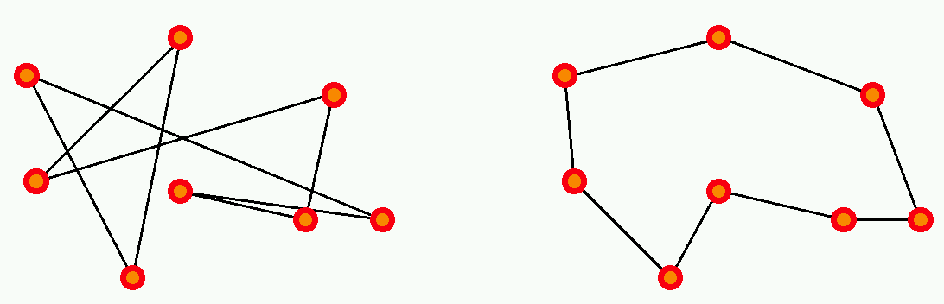
Complexity example: Traveling Salesman Problem
There are n cities, with a road of length L_{ij} joining
city i to city j.
The salesman wishes to find a way to visit all cities that
is optimal in two ways:
each city is visited only once, and
the total route is as short as possible.

Slide 75
Complexity example: Traveling Salesman Problem
This is a hard problem: the only known algorithms (so far) to solve it have exponential complexity, that is, the number of operations required to solve it grows as exp(n) for n cities.

Slide 76
Why is exponential complexity “hard”?
It means that the number of operations necessary to compute the exact solution of the problem grows exponentially with the size of the problem (here, the number of cities).
exp(1) = 2.72
exp(10) = 2.20 10⁴ (daily salesman trip)
exp(100) = 2.69 10⁴³ (monthly salesman planning)
exp(500) = 1.40 10²¹⁷ (music band worldwide tour)
exp(250,000) = 10^{108,573} (fedex, postal services)
Fastest
computer = 10¹² operations/second

Slide 77
So…
In general, exponential-complexity problems cannot be solved for any but the smallest instances!

Slide 78
Complexity
Polynomial-time (P) problems: we can find algorithms that will solve them in a time (=number of operations) that grows polynomially with the size of the input.
for example: sort n numbers into increasing order: poor algorithms have n^2 complexity, better ones have n log(n) complexity.

Slide 79
Complexity
Since we did not state what the order of the polynomial is, it could be very large! Are there algorithms that require more than polynomial time?
Yes (until proof of the contrary); for some algorithms, we do not know of any polynomial-time algorithm to solve them. These belong to the class of nondeterministic-polynomial-time (NP) algorithms (which includes P problems as well as harder ones).
for example: traveling salesman problem.
In particular, exponential-time algorithms are believed to be NP.

Slide 80
Note on NP-hard problems
The formal definition of NP problems is:
A problem is nondeterministic polynomial if there exists some algorithm that can guess a solution and then verify whether or not the guess is correct in polynomial time.
(one can also state this as these problems being solvable in polynomial time on a nondeterministic Turing machine.)
In practice, until proof of the contrary, this means that known algorithms that run on known computer architectures will take more than polynomial time to solve the problem.

Slide 81
Complexity: O() and o() measures (Landau symbols)
How can we represent the complexity of an algorithm?
Given: Problem input (or instance) size: n
Number of operations to solve problem: f(n)
If, for a given function g(n), we have:
then f is dominated by g
If, for a given function g(n), we have:
then f is negligible compared to g

Slide 82
Landau symbols
is bounded

Slide 83
Examples, properties
f(n)=n, g(n)=n^2:
n is o(n^2), because n/n^2 = 1/n -> 0 as n ->infinity
similarly, log(n) is o(n)
n^C is o(exp(n)) for any C
if f is O(g), then for any K, K.f is also O(g); idem for o()
if f is O(h) and g is O(h), then for any K, L: K.f + L.g is O(h)
idem for o()
if f is O(g) and g is O(h), then f is O(h)
if f is O(g) and g is o(h), then f is o(h)
if f is o(g) and g is O(h), then f is o(h)

Slide 84
Polynomial-time hierarchy
From Handbook of Brain
Theory & Neural Networks
(Arbib, ed.;
MIT Press 1995).
NP
P
AC⁰
NC¹
NC
P complete
NP complete
PH
AC⁰: can be solved using gates of constant depth
NC¹: can be solved in logarithmic depth using 2-input gates
NC: can be solved by small, fast parallel computer
P: can be solved in polynomial time
P-complete: hardest problems in P; if one of them can be proven to be
NC, then P = NC
NP: nondeterministic-polynomial algorithms
NP-complete: hardest NP problems; if one of them can be proven to be
P, then NP = P
PH: polynomial-time hierarchy

Slide 85

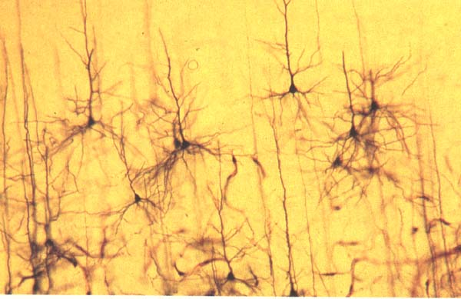
Complexity and the human brain
Are computers close to human brain power?
Current computer chip (CPU):
10^3 inputs (pins)
10^7 processing elements (gates)
2 inputs per processing element (fan-in = 2)
processing elements compute boolean logic (OR, AND, NOT, etc)
Typical human brain:
10^7 inputs (sensors)
10^10 processing elements (neurons)
fan-in = 10^3
processing elements compute complicated
functions
Still a lot of improvement needed for computers; but
computer clusters come close!

Slide 86
Remember: Implementation of search algorithms
Function General-Search(problem, Queuing-Fn) returns a solution, or failure
nodes ← make-queue(make-node(initial-state[problem]))
loop do
if nodes is empty then return failure
node ← Remove-Front(nodes)
if Goal-Test[problem] applied to State(node) succeeds then return node
nodes ← Queuing-Fn(nodes, Expand(node, Operators[problem]))
end
Queuing-Fn(queue, elements) is a queuing function that inserts a set of elements into the queue and determines the order of node expansion. Varieties of the queuing function produce varieties of the search algorithm.

Slide 87
Encapsulating state information in nodes

Slide 88
Evaluation of search strategies
A search strategy is defined by picking the order of node expansion.
Search algorithms are commonly evaluated according to the following four criteria:
Completeness: does it always find a solution if one exists?
Time complexity: how long does it take as function of num. of nodes?
Space complexity: how much memory does it require?
Optimality: does it guarantee the least-cost solution?
Time and space complexity are measured in terms of:
b – max branching factor of the search tree
d – depth of the least-cost solution
m – max depth of the search tree (may be infinity)

Slide 89
Note: Approximations
In our complexity analysis, we do not take the built-in loop-detection into account.
The results only ‘formally’ apply to the variants of our algorithms WITHOUT loop-checks.
Studying the effect of the loop-checking on the complexity is hard:
overhead of the checking MAY or MAY NOT be compensated by the reduction of the size of the tree.
Also: our analysis DOES NOT take the length (space) of representing paths into account !!
http://www.cs.kuleuven.ac.be/~dannyd/FAI/

Slide 90
Uninformed search strategies
Use only information available in the problem formulation
Breadth-first
Uniform-cost
Depth-first
Depth-limited
Iterative deepening

Slide 91

Breadth-first search

Slide 92
Breadth-first search
S
A
D
Move downwards, level by level, until goal is reached.
B
D
A
E
C
E
E
B
B
F
D
F
B
F
C
E
A
C
G
G
C
G
F
G

Slide 93
Example: Traveling from Arad To Bucharest

Slide 94
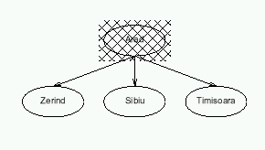
Breadth-first search

Slide 95
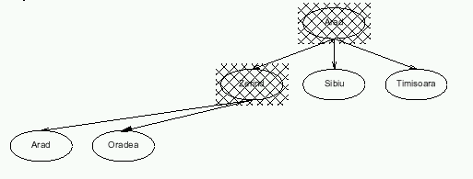
Breadth-first search

Slide 96
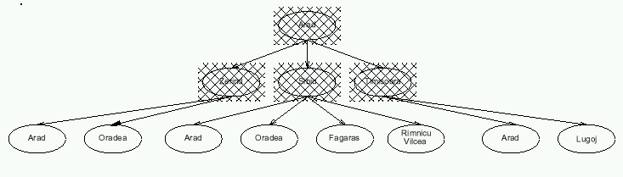
Breadth-first search

Slide 97
Properties of breadth-first search
Completeness:
Time complexity:
Space complexity:
Optimality:
Search algorithms are commonly evaluated according to the following four criteria:
Completeness: does it always find a solution if one exists?
Time complexity: how long does it take as function of num. of nodes?
Space complexity: how much memory does it require?
Optimality: does it guarantee the least-cost solution?
Time and space complexity are measured in terms of:
b – max branching factor of the search tree
d – depth of the least-cost solution
m – max depth of the search tree (may be infinity)

Slide 98
Properties of breadth-first search
Completeness: Yes, if b is finite
Time complexity: 1+b+b²+…+b^{d} = O(b ^{d}), i.e., exponential in d
Space complexity: O(b ^{d}) (see following slides)
Optimality: Yes (assuming cost = 1 per step)

Slide 99
Time complexity of breadth-first search
If a goal node is found on depth d of the tree, all nodes up till that depth are created and examined (note: and the children of nodes at depth d are created and enqueued, but not yet examined).
d
m
b
G
Thus: O(b^{d})

Slide 100
Space complexity of breadth-first
Largest number of nodes in QUEUE is reached on the level d+1 just beyond the goal node.
d
b
G
QUEUE contains all nodes. (Thus: 4) .
In General: b^{d+1} – b ~ b^{d}

Slide 101
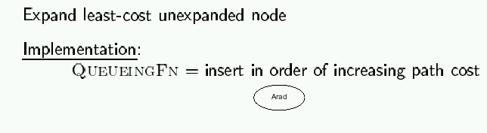
Uniform-cost search
So, the queueing function keeps the node list sorted by increasing path cost, and we expand the first unexpanded node (hence with smallest path cost)
A refinement of the breadth-first strategy:
Breadth-first = uniform-cost with path cost = node depth

Slide 102
Romania with step costs in km

Slide 103
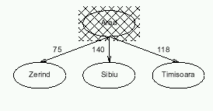
Uniform-cost search

Slide 104
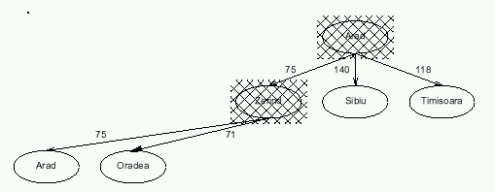
Uniform-cost search

Slide 105
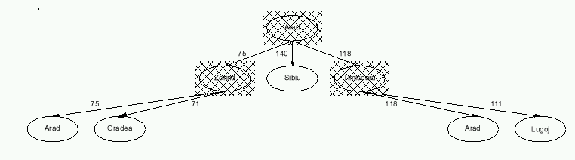
Uniform-cost search

Slide 106
Properties of uniform-cost search
Completeness: Yes, if step cost ≥ ε >0
Time complexity: # nodes with g ≤ cost of optimal solution, ≤ O(b ^{d})
Space complexity: # nodes with g ≤ cost of optimal solution, ≤ O(b ^{d})
Optimality: Yes, as long as path cost never decreases
g(n) is the path cost to node n
Remember:
b = branching factor
d = depth of least-cost solution

Slide 107
Implementation of uniform-cost search
Initialize Queue with root node (built from start state)
Repeat until (Queue empty) or (first node has Goal state):
Remove first node from front of Queue
Expand node (find its children)
Reject those children that have already been considered, to avoid loops
Add remaining children to Queue, in a way that keeps entire queue sorted by increasing path cost
If Goal was reached, return success, otherwise failure

Slide 108
Caution!
Uniform-cost search not optimal if it is terminated when any node in the queue has goal state.
1
S
1
5
A
5
1
C
2
B
5
Uniform cost returns the path with cost 102 (if any goal node is considered a solution), while there is a path with cost 25.
D
10
5
100
E
15
5
F
20
G
5

Slide 109
Note: Loop Detection
In class, we saw that the search may fail or be sub-optimal if:
- no loop detection: then algorithm runs into infinite cycles
(A -> B -> A -> B -> …)
- not queuing-up a node that has a state which we have
already visited: may yield suboptimal solution
- simply avoiding to go back to our parent: looks promising,
but we have not proven that it works
Solution? do not enqueue a node if its state matches the state of any of its parents (assuming path costs>0).
Indeed, if path costs > 0, it will always cost us more to consider a node with that state again than it had already cost us the first time.
Is that enough??

Slide 110
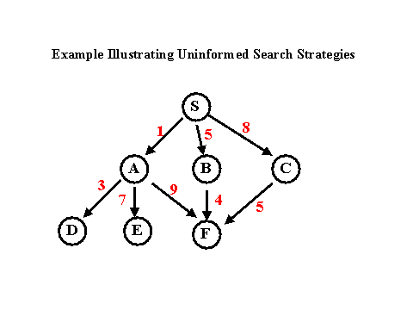
Example
From: http://www.csee.umbc.edu/471/current/notes/uninformed-search/
G

Slide 111
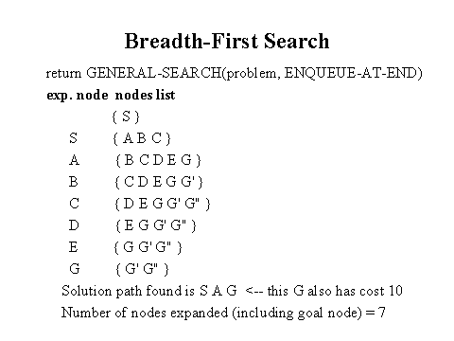
Breadth-First Search Solution
From: http://www.csee.umbc.edu/471/current/notes/uninformed-search/

Slide 112
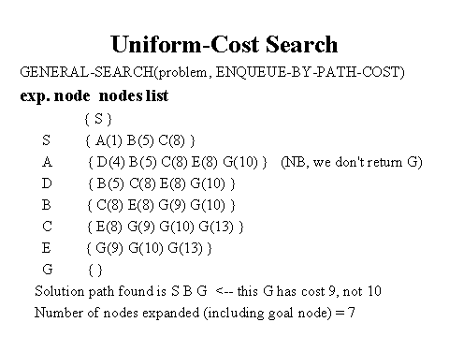
Uniform-Cost Search Solution
From: http://www.csee.umbc.edu/471/current/notes/uninformed-search/

Slide 113
Note: Queueing in Uniform-Cost Search
In the previous example, it is wasteful (but not incorrect) to queue-up three nodes with G state, if our goal if to find the least-cost solution:
Although they represent different paths, we know for sure that the one with smallest path cost (9 in the example) will yield a solution with smaller total path cost than the others.
So we can refine the queueing function by:
- queue-up node if
1) its state does not match the state of any parent
and 2) path cost smaller than path cost of any
unexpanded node with same state in the queue (and in this case, replace old node with same
state by our new node)
Is that it??

Slide 114
A Clean Robust Algorithm
Function UniformCost-Search(problem, Queuing-Fn) returns a solution, or failure
open ← make-queue(make-node(initial-state[problem]))
closed ← [empty]
loop do
if open is empty then return failure
currnode ← Remove-Front(open)
if Goal-Test[problem] applied to State(currnode) then return currnode
children ← Expand(currnode, Operators[problem])
while children not empty
[… see next slide …]
end
closed ← Insert(closed, currnode)
open ← Sort-By-PathCost(open)
end

Slide 115
A Clean Robust Algorithm
[… see previous slide …]
children ← Expand(currnode, Operators[problem])
while children not empty
child ← Remove-Front(children)
if no node in open or closed has child’s state
open ← Queuing-Fn(open, child)
else if there exists node in open that has child’s state
if PathCost(child) < PathCost(node)
open ← Delete-Node(open, node)
open ← Queuing-Fn(open, child)
else if there exists node in closed that has child’s state
if PathCost(child) < PathCost(node)
closed ← Delete-Node(closed, node)
open ← Queuing-Fn(open, child)
end
[… see previous slide …]

Slide 116
Example
S
# State Depth Cost Parent
1 S 0 0 -
1
5
A
1
C
B
5
1
D
5
100
E
F
5
G
5

Slide 117
Example
S
# State Depth Cost Parent
1 S 0 0 -
2 A 1 1 1
3 C 1 5 1
1
5
A
1
C
B
5
1
D
5
100
E
Black = open queue
Grey = closed queue
F
5
Insert expanded nodes
Such as to keep open queue
sorted
G
5

Slide 118
Example
S
# State Depth Cost Parent
1 S 0 0 -
2 A 1 1 1
4 B 2 2 2
3 C 1 5 1
1
5
A
1
C
B
5
1
D
5
E
Node 2 has 2 successors: one with state B
and one with state S.
We have node #1 in closed with state S;
but its path cost 0 is smaller than the path
cost obtained by expanding from A to S.
So we do not queue-up the successor of
node 2 that has state S.
100
F
5
G
5

Slide 119
Example
S
# State Depth Cost Parent
1 S 0 0 -
2 A 1 1 1
4 B 2 2 2
5 C 3 3 4
6 G 3 102 4
1
5
A
1
C
B
5
1
D
5
E
Node 4 has a successor with state C and
Cost smaller than node #3 in open that
Also had state C; so we update open
To reflect the shortest path.
100
F
5
G
5

Slide 120
Example
S
# State Depth Cost Parent
1 S 0 0 -
2 A 1 1 1
4 B 2 2 2
5 C 3 3 4
7 D 4 8 5
6 G 3 102 4
1
5
A
1
C
B
5
1
D
5
100
E
F
5
G
5

Slide 121
Example
S
# State Depth Cost Parent
1 S 0 0 -
2 A 1 1 1
4 B 2 2 2
5 C 3 3 4
7 D 4 8 5
8 E 5 13 7
6 G 3 102 4
1
5
A
1
C
B
5
1
D
5
100
E
F
5
G
5

Slide 122
Example
S
# State Depth Cost Parent
1 S 0 0 -
2 A 1 1 1
4 B 2 2 2
5 C 3 3 4
7 D 4 8 5
8 E 5 13 7
9 F 6 18 8
6 G 3 102 4
1
5
A
1
C
B
5
1
D
5
100
E
F
5
G
5

Slide 123
Example
S
# State Depth Cost Parent
1 S 0 0 -
2 A 1 1 1
4 B 2 2 2
5 C 3 3 4
7 D 4 8 5
8 E 5 13 7
9 F 6 18 8
10 G 7 23 9
1
5
A
1
C
B
5
1
D
5
100
E
F
5
G
The node with state G and cost 102 has been removed from the open queue and replaced by cheaper node with state G and code 23 which was pushed into the open queue.
5

Slide 124
Example
S
# State Depth Cost Parent
1 S 0 0 -
2 A 1 1 1
4 B 2 2 2
5 C 3 3 4
7 D 4 8 5
8 E 5 13 7
9 F 6 18 8
10 G 7 23 9
1
5
A
1
C
B
5
1
D
5
100
E
F
5
G
5
Goal reached

Slide 125
More examples…
See the great demos at:
http://pages.pomona.edu/~jbm04747/courses/spring2001/cs151/Search/Strategies.html

Slide 126
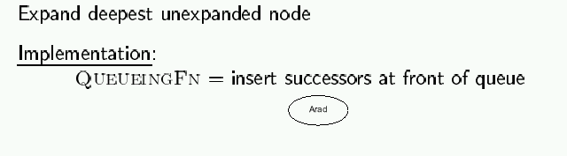
Depth-first search

Slide 127
Depth First Search
S
A
B
C
E
D
F
G

Slide 128
Romania with step costs in km

Slide 129
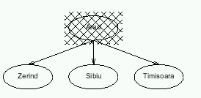
Depth-first search

Slide 130
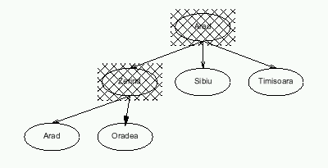
Depth-first search

Slide 131
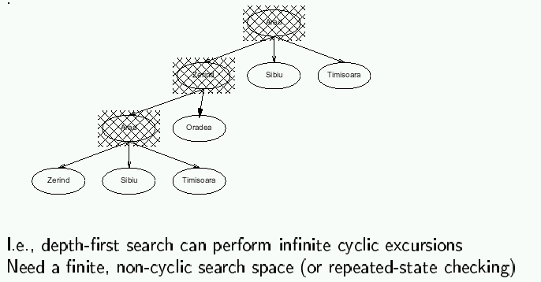
Depth-first search

Slide 132
Properties of depth-first search
Completeness: No, fails in infinite state-space (yes if finite state space)
Time complexity: O(b ^{m})
Space complexity: O(bm)
Optimality: No
Remember:
b = branching factor
m = max depth of search tree

Slide 133
Time complexity of depth-first: details
In the worst case:
the (only) goal node may be on the right-most branch,
m
b
G
Time complexity == b^{m} + b^{m-1} + … + 1 = b^{m+1} -1
Thus: O(b^{m})
b - 1

Slide 134
Space complexity of depth-first
Largest number of nodes in QUEUE is reached in bottom left-most node.
Example: m = 3, b = 3 :
G
...
QUEUE contains all nodes. Thus: 4.
In General: ((b-1) * m)
Order: O(m*b)

Slide 135
Avoiding repeated states
In increasing order of effectiveness and computational overhead:
do not return to state we come from, i.e., expand function will skip possible successors that are in same state as node’s parent.
do not create paths with cycles, i.e., expand function will skip possible successors that are in same state as any of node’s ancestors.
do not generate any state that was ever generated before, by keeping track (in memory) of every state generated, unless the cost of reaching that state is lower than last time we reached it.

Slide 136
Depth-limited search
Is a depth-first search with depth limit l
Implementation: Nodes at depth l have no successors.
Complete: if cutoff chosen appropriately then it is guaranteed to find a solution.
Optimal: it does not guarantee to find the least-cost solution

Slide 137
Iterative deepening search
Function Iterative-deepening-Search(problem) returns a solution,
or failure
for depth = 0 to ∞ do
result ← Depth-Limited-Search(problem, depth)
if result succeeds then return result
end
return failure
Combines the best of breadth-first and depth-first search strategies.
Completeness: Yes,
Time complexity: O(b ^{d})
Space complexity: O(bd)
Optimality: Yes, if step cost = 1

Slide 138
Romania with step costs in km

Slide 139
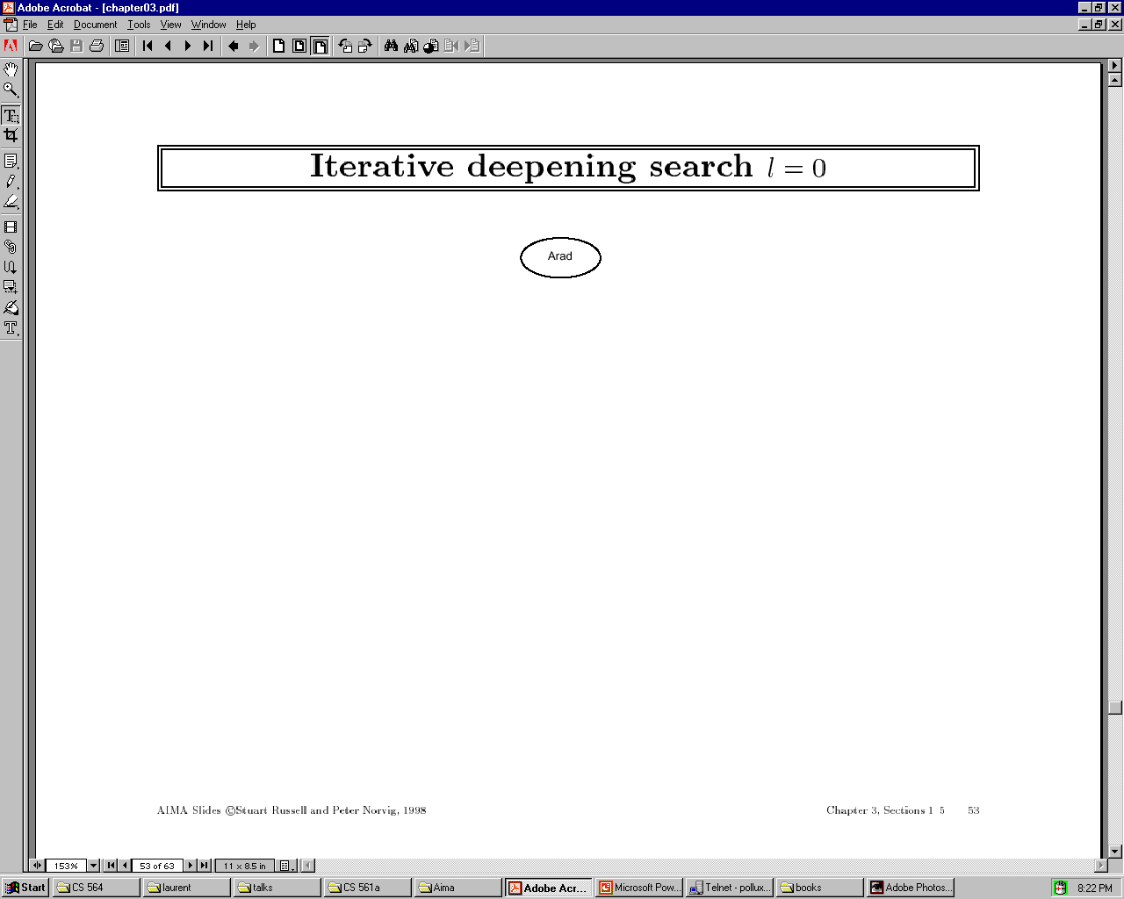

Slide 140


Slide 141
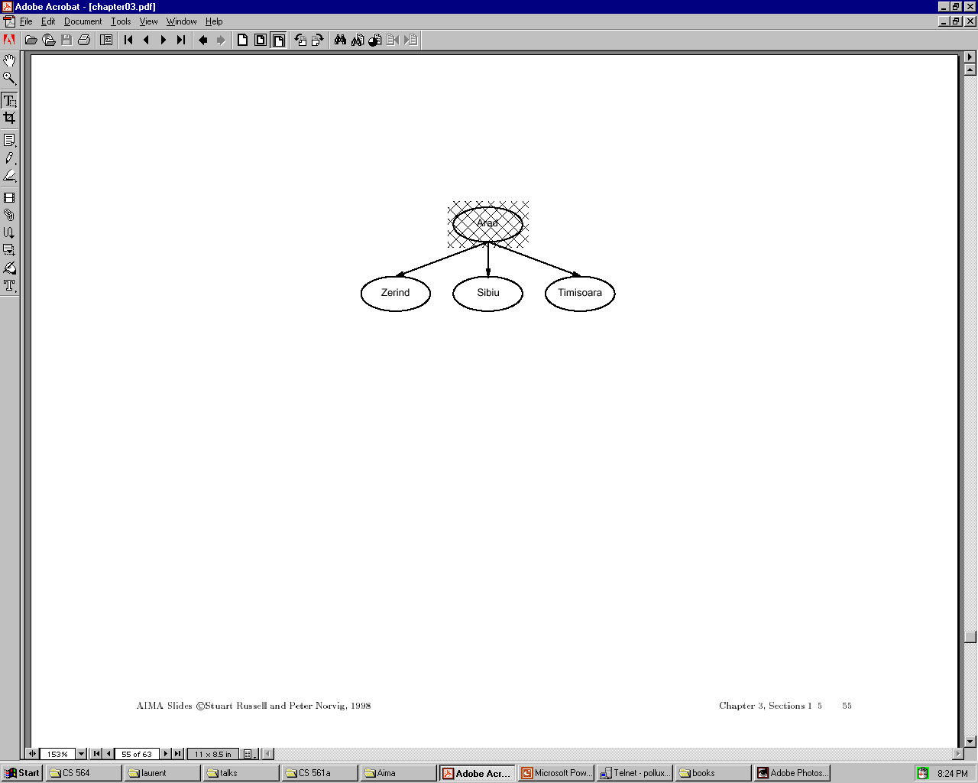

Slide 142


Slide 143


Slide 144
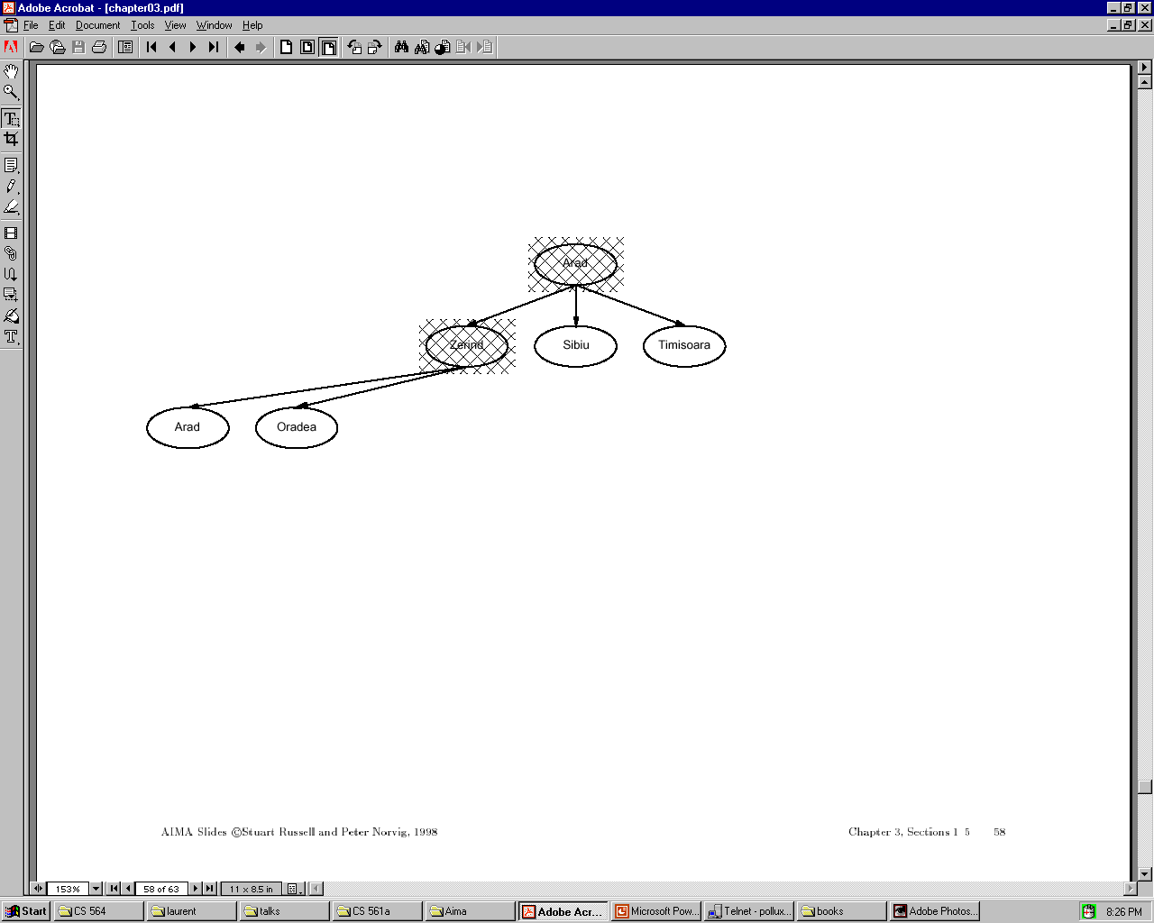

Slide 145
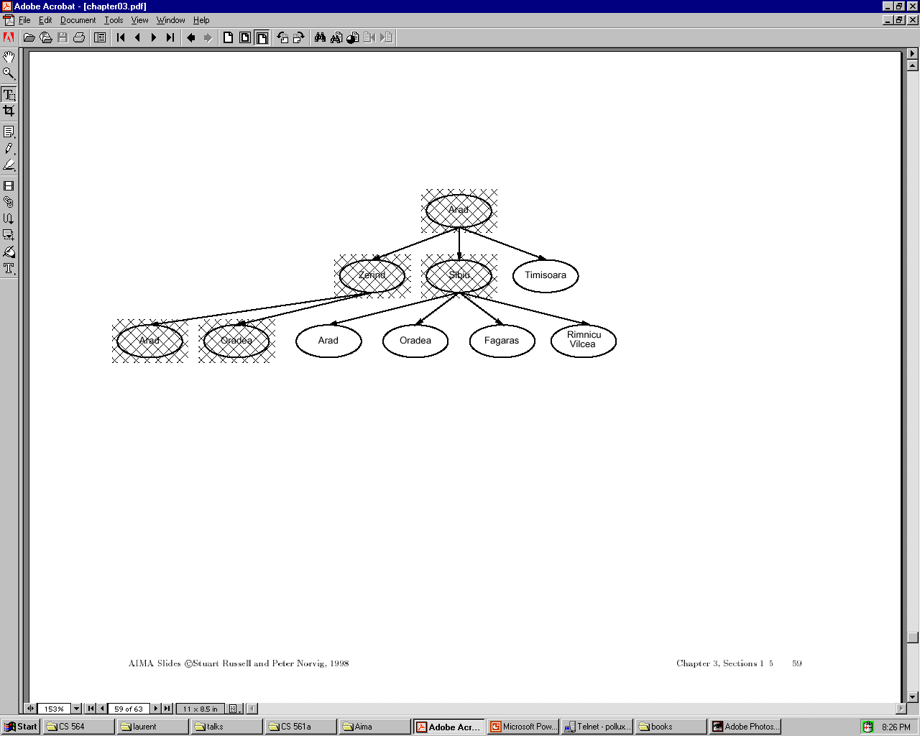

Slide 146
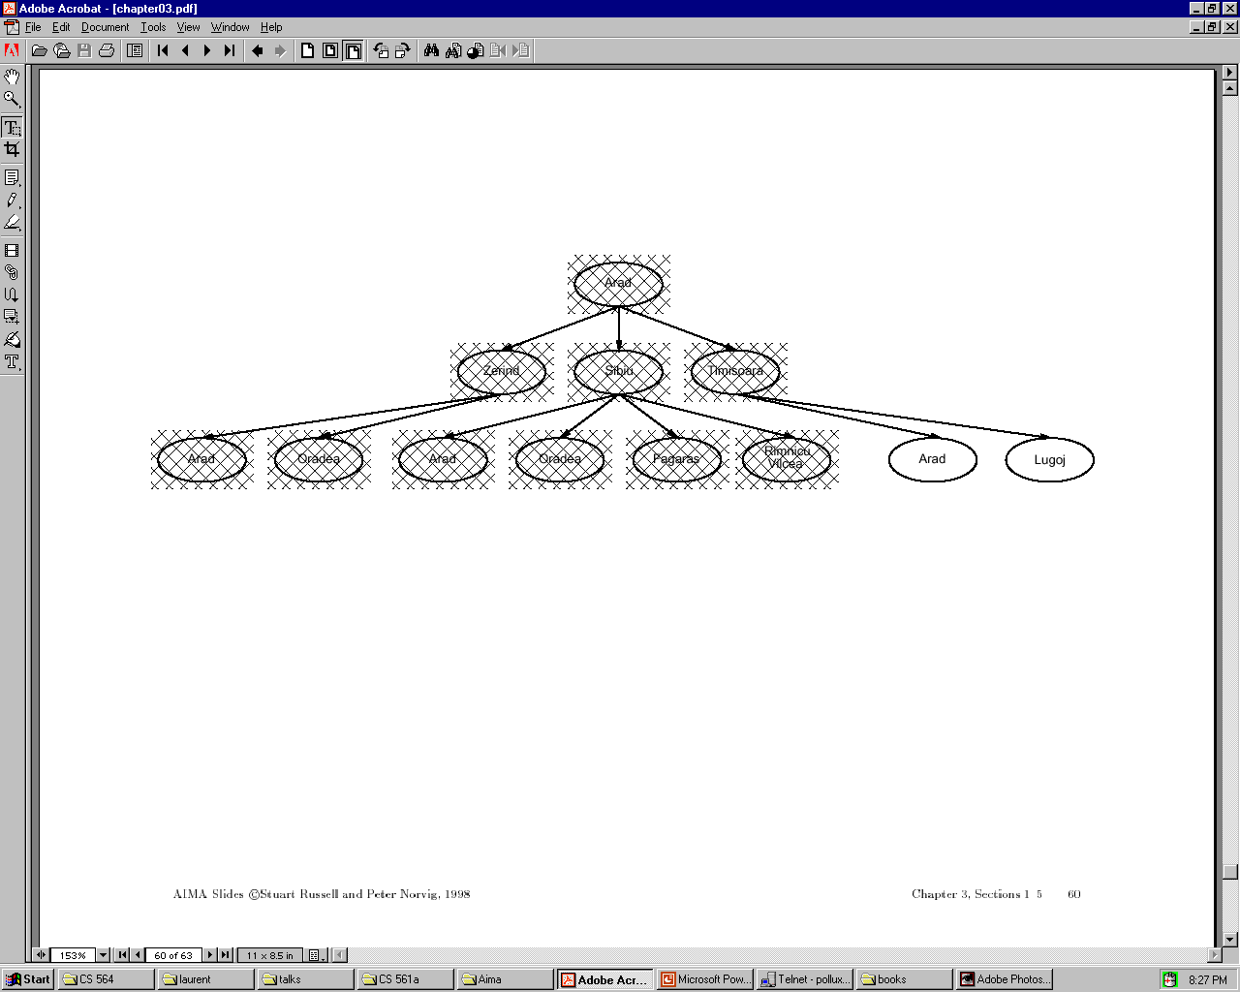

Slide 147
Iterative deepening complexity
Iterative deepening search may seem wasteful because so many states are expanded multiple times.
In practice, however, the overhead of these multiple expansions is small, because most of the nodes are towards leaves (bottom) of the search tree:
thus, the nodes that are evaluated several times (towards top of tree) are in relatively small number.

Slide 148
Iterative deepening complexity
In iterative deepening, nodes at bottom level are expanded once, level above twice, etc. up to root (expanded d+1 times) so total number of expansions is:
(d+1)1 + (d)b + (d-1)b^2 + … + 3b^(d-2) + 2b^(d-1) + 1b^d = O(b^d)
In general, iterative deepening is preferred to depth-first or breadth-first when search space large and depth of solution not known.

Slide 149
Bidirectional search
Both search forward from initial state, and backwards from goal.
Stop when the two searches meet in the middle.
Problem: how do we search backwards from goal??
predecessor of node n = all nodes that have n as successor
this may not always be easy to compute!
if several goal states, apply predecessor function to them just as we applied successor (only works well if goals are explicitly known; may be difficult if goals only characterized implicitly).
Start
Goal

Slide 150
Bidirectional search
Problem: how do we search backwards from goal?? (cont.)
…
for bidirectional search to work well, there must be an efficient way to check whether a given node belongs to the other search tree.
select a given search algorithm for each half.
Start
Goal

Slide 151
Bidirectional search
1. QUEUE1 <-- path only containing the root;
QUEUE2 <-- path only containing the goal;
2. WHILE both QUEUEs are not empty
AND QUEUE1 and QUEUE2 do NOT share a state
DO remove their first paths;
create their new paths (to all children);
reject their new paths with loops;
add their new paths to back;
3. IF QUEUE1 and QUEUE2 share a state
THEN success;
ELSE failure;

Slide 152
Bidirectional search
Completeness: Yes,
Time complexity: 2*O(b ^{d/2}) = O(b ^{d/2})
Space complexity: O(b ^{m/2})
Optimality: Yes
To avoid one by one comparison, we need a hash table of size O(b ^{m/2})
If hash table is used, the cost of comparison is O(1)

Slide 153
Bidirectional Search
Initial State
Final State
d / 2
d

Slide 154
Bidirectional search
Bidirectional search merits:
Big difference for problems with branching factor b in both directions
A solution of length d will be found in O(2b^{d/2}) = O(b^{d/2})
For b = 10 and d = 6, only 2,222 nodes are needed instead of 1,111,111 for breadth-first search

Slide 155
Bidirectional search
Bidirectional search issues
Predecessors of a node need to be generated
Difficult when operators are not reversible
What to do if there is no explicit list of goal states?
For each node: check if it appeared in the other search
Needs a hash table of O(b^{d/2})
What is the best search strategy for the two searches?

Slide 156
Comparing uninformed search strategies
Criterion Breadth- Uniform Depth- Depth- Iterative Bidirectional
first cost first limited deepening (if applicable)
Time b^d b^d b^m b^l b^d b^(d/2)
Space b^d b^d bm bl bd b^(d/2)
Optimal? Yes Yes No No Yes Yes
Complete? Yes Yes No Yes, Yes Yes
if l≥d
b – max branching factor of the search tree
d – depth of the least-cost solution
m – max depth of the state-space (may be infinity)
l – depth cutoff

Slide 157
Summary
Problem formulation usually requires abstracting away real-world details to define a state space that can be explored using computer algorithms.
Once problem is formulated in abstract form, complexity analysis helps us picking out best algorithm to solve problem.
Variety of uninformed search strategies; difference lies in method used to pick node that will be further expanded.
Iterative deepening search only uses linear space and not much more time than other uniformed search strategies.

